Slide 2
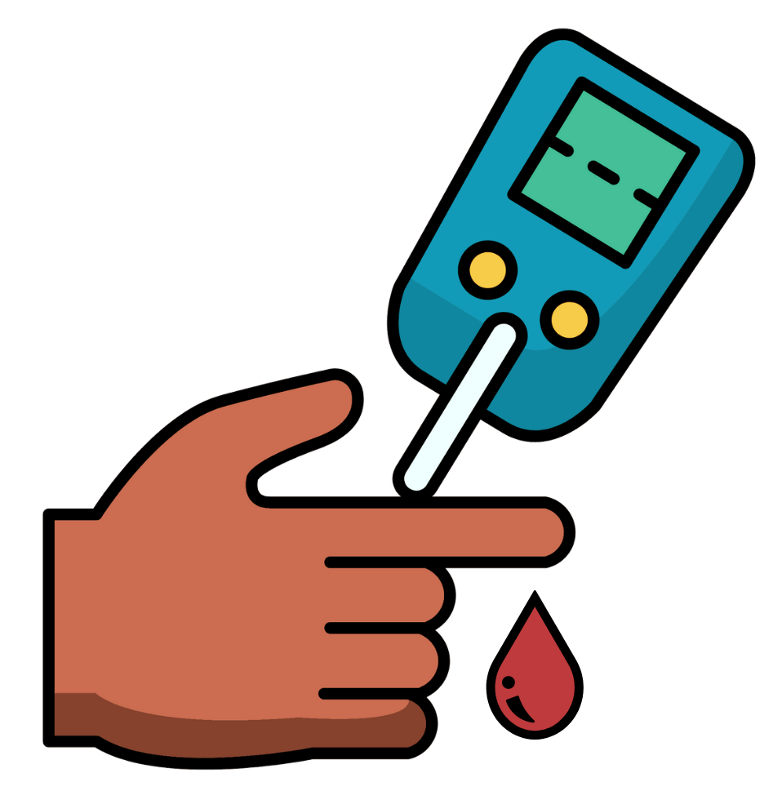
Type 2 diabetes is a sickness that people can get. It affects anyone, even young people.
When we have diabetes and we eat sugar, we might get sick. We might also feel tired and thirsty all the time.
We get diabetes when our bodies have trouble with insulin. Insulin is the energy that is used for the body to work (like the petrol that makes a car drive).

Slide 3
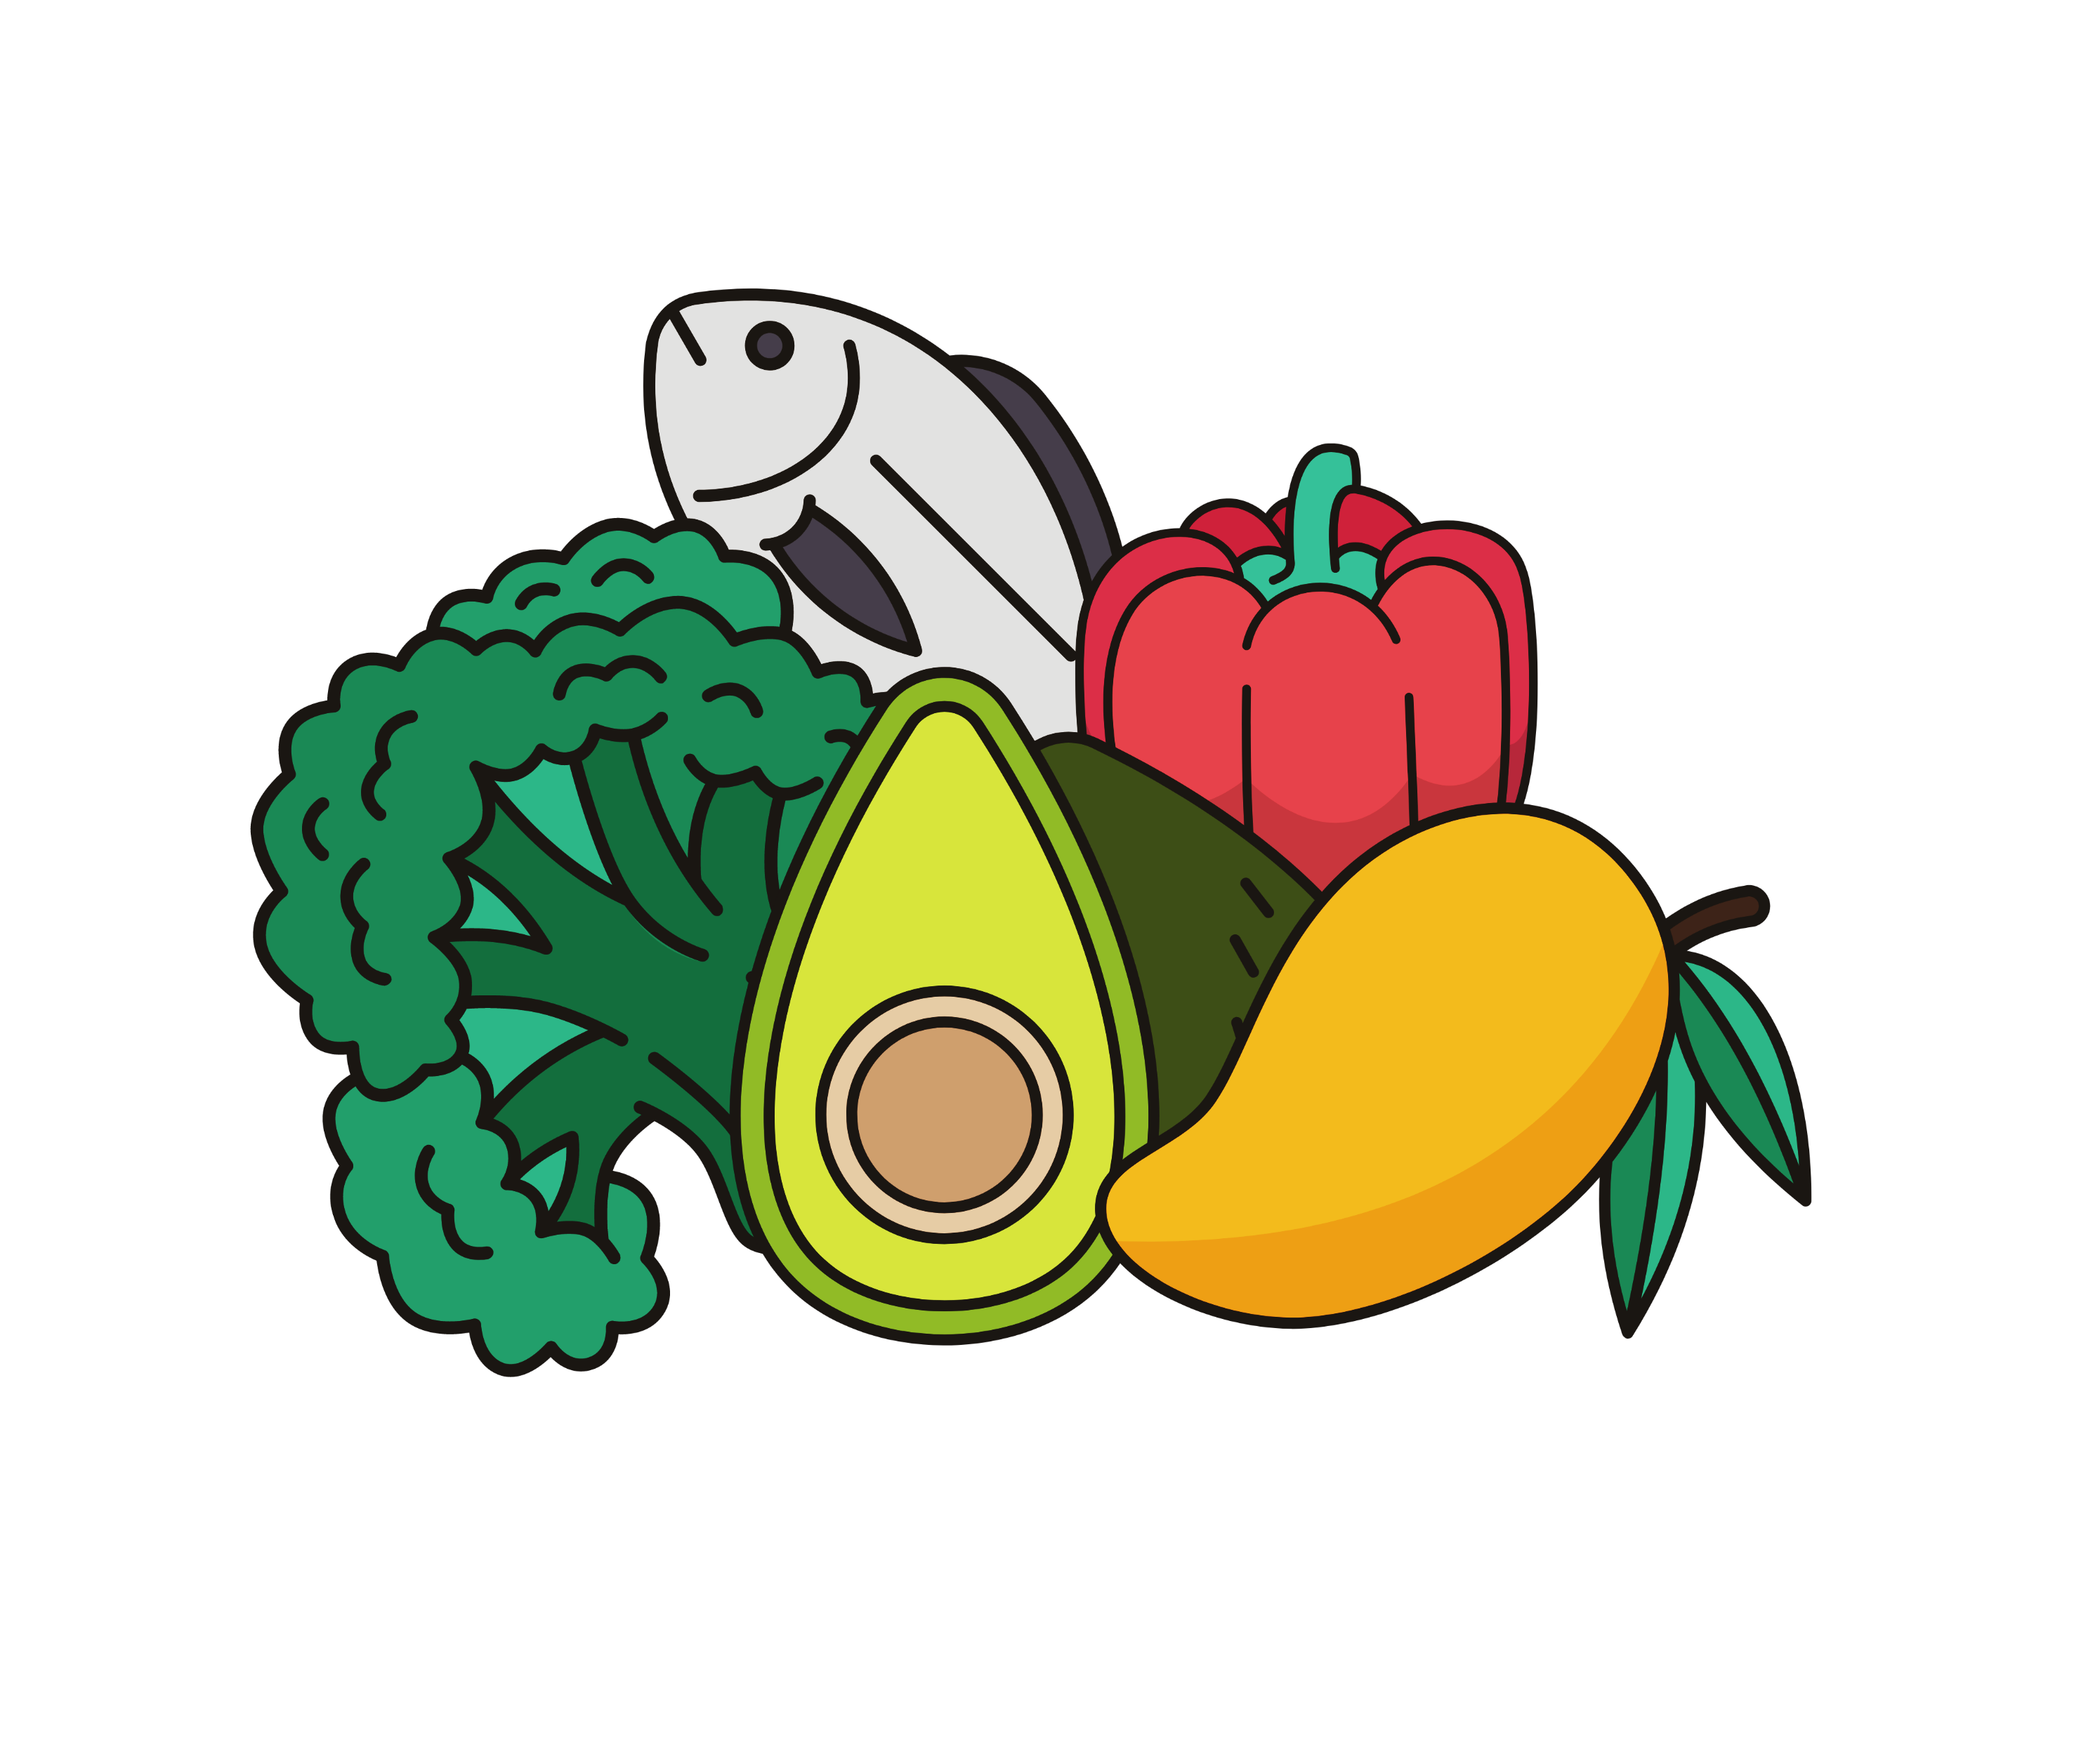
When we eat food, insulin changes. Insulin converts food into energy so that we can move around. When we get diabetes and eat lots of sugar, our body doesn’t work properly because there is too much sugar in the blood. Diabetes can hurt the kidney, eyes, heart, and feet.
People with type 2 diabetes can stay healthy and strong by looking after our bodies. We can look after our bodies by taking medicines, eating healthy food, cutting down on sugar, doing lots of exercise, and getting help from health professionals, our elders, and our families.

Slide 4
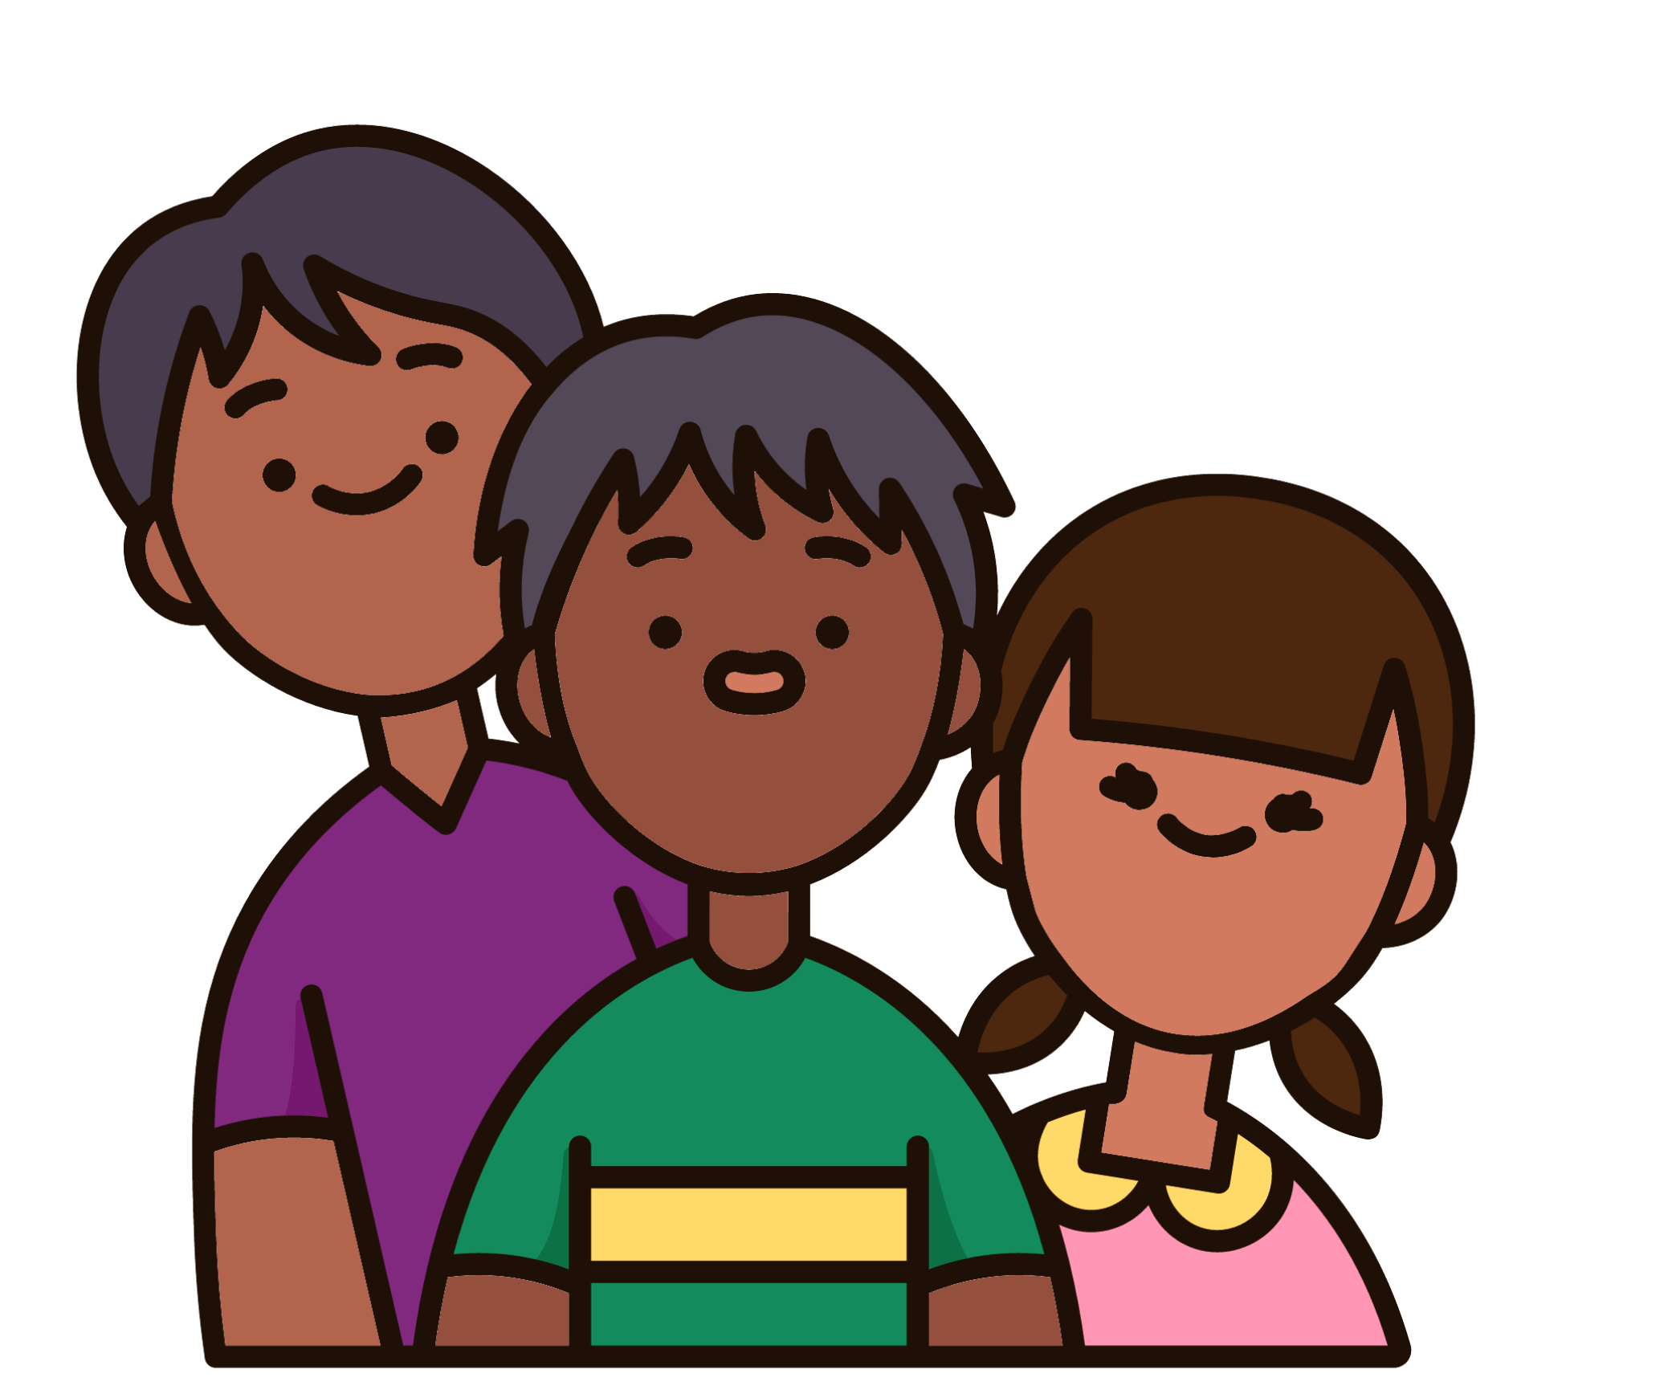
Sometimes diabetes can run through families.
Sometimes its hard to eat good food and cost lots of money. We can get diabetes from eating unhealthy food, especially food with lots of sugar.
In the old days, First Nations people were very fit and strong from hunting and gathering. Now our lives our different, but we can still stay fit and strong from visiting country, playing sports, going for long walks, or doing other exercise.

Slide 5
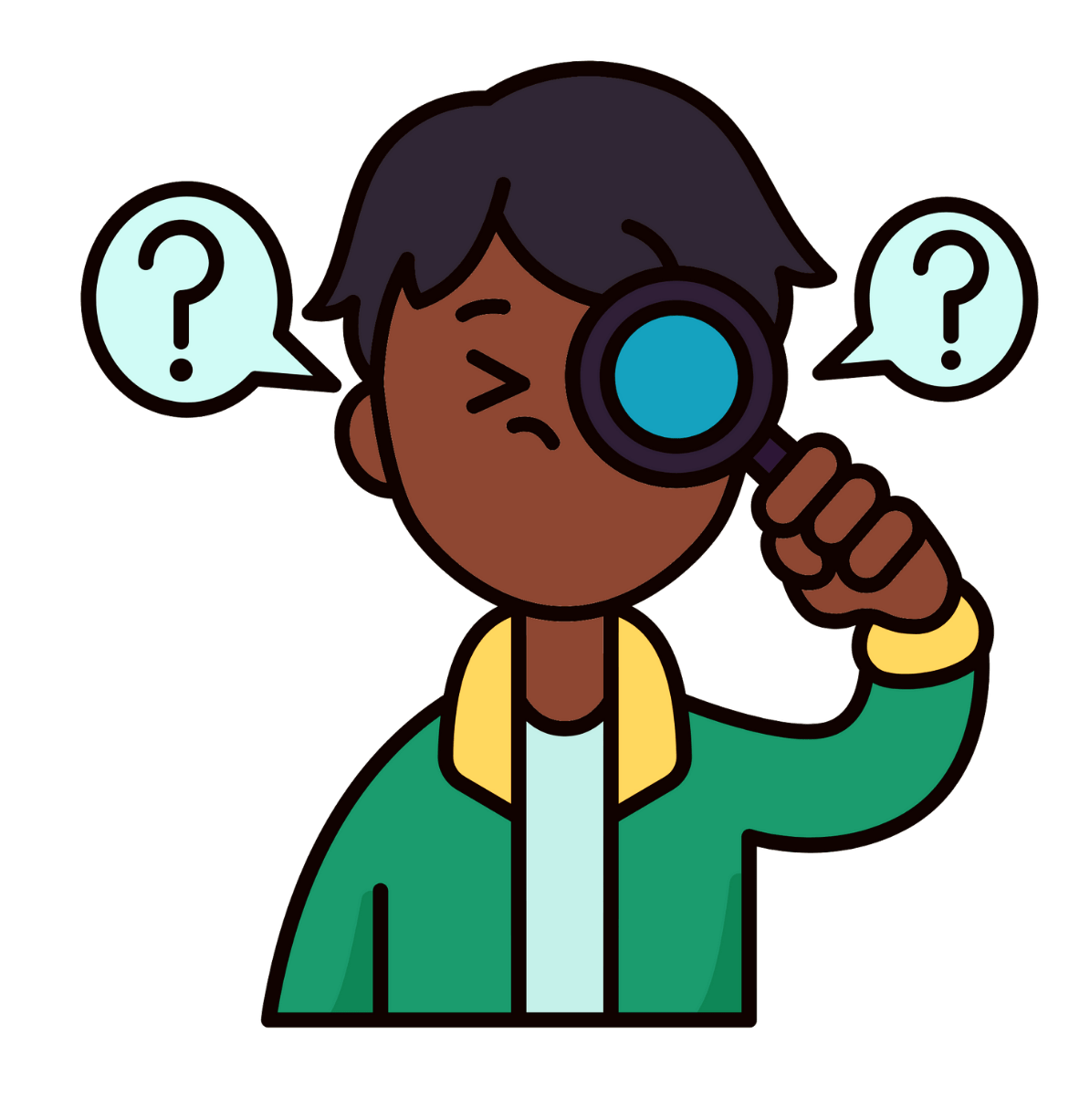
We know that type 2 diabetes is impacting Aboriginal and Torres Strait Islander people more than anyone else.
Type 2 diabetes is different in young people than in people over 25 years old.
To stay healthy and strong, it’s important that young people have the right information and support.
Health workers are important for managing type 2 diabetes. They can help to diagnose it early and support young people to manage it well.

Slide 6
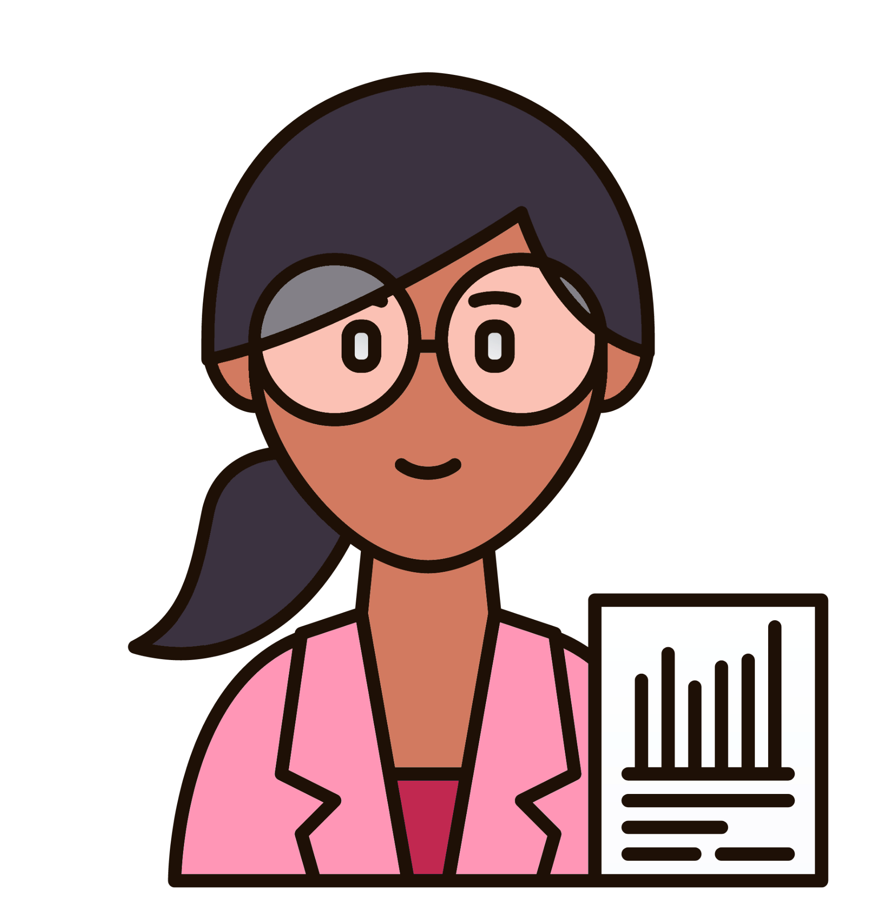
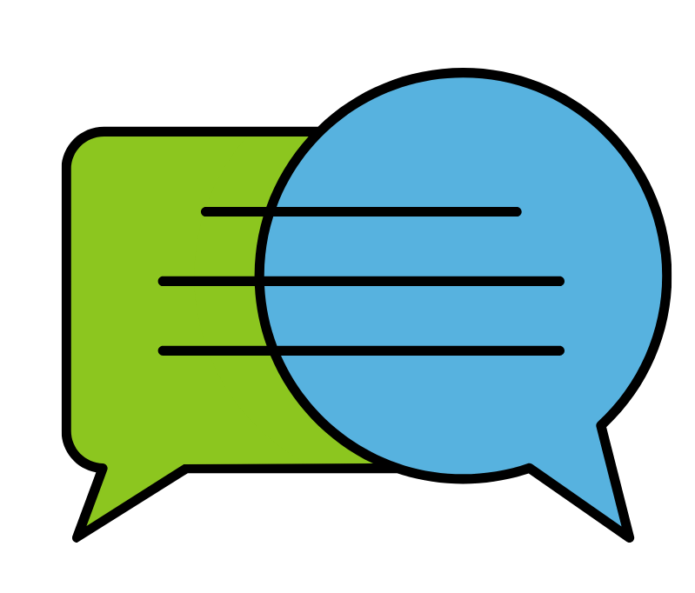
Come have a yarn with researchers
Share your story
Share ideas of how to support young people

Slide 7
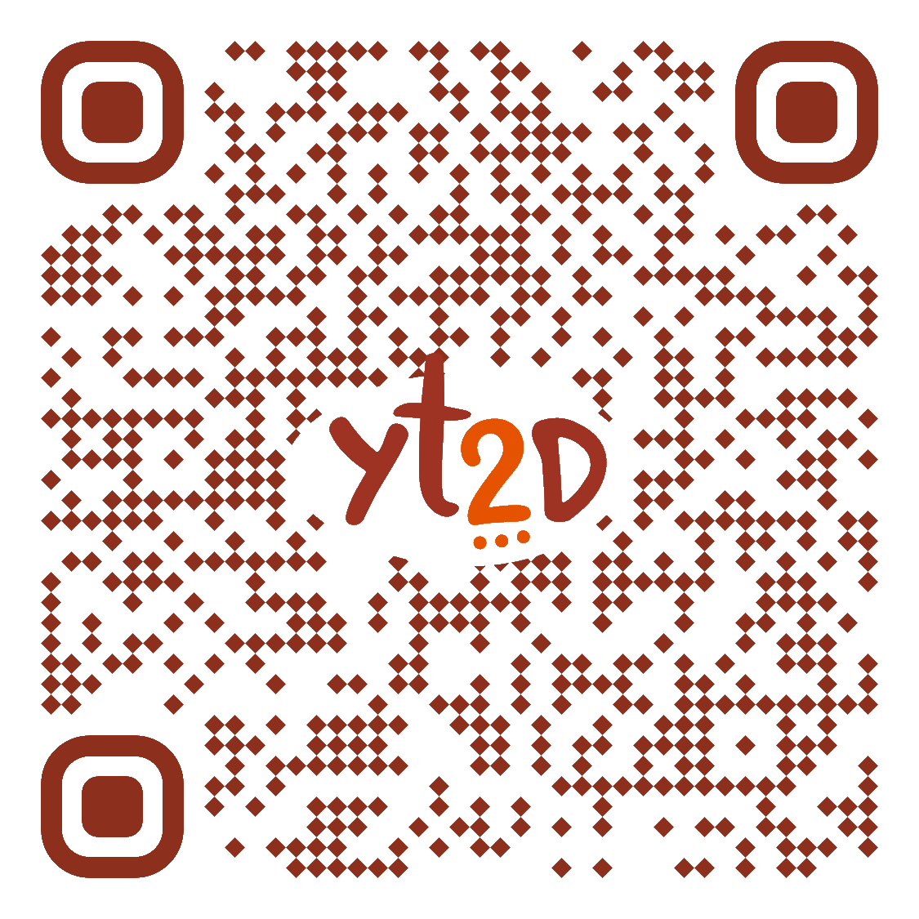
CONTACT
youth.diabetes@menzies.edu.au
WEBSITE
diabeteslifecourse.org.au/youth-diabetes

